Slide 1

KGiSL INSTITUTE OF TECHNOLOGY
COIMBATORE
DEPARTMENT OF computer science & engineering
Project review # 03
Title: IOT Based Vehicle Emission Monitoring System
TEAM MEMBERS:
711720104011 ASHWIN B
711720104034 KAUSHIK S
711720104046 MOHAN K
711720104041 MATHANCHANDRU S
Under the guidance of : Mr GNANAVEL M

Slide 2

Agenda
ABSTRACT
EXISTING SYSTEM
LITERATURE REVIEW
PROPOSED SYSTEM
MODULES SPLIT UP
BLOCK DIAGRAM
COMPONENTS USED
CIRCUIT DESIGN
FLOW CHART
EXPECTED OUTCOME
PROJECT-THIRD REVIEW ,
Department of CSE, KGiSL Institute of Technology, Coimbatore

Slide 3
Abstract
The increase in automobiles significantly contributes to air pollution through emissions of nitrogen oxides (NOx), carbon monoxide (CO), and hydrocarbons (HC). Vehicles are responsible for about half of NOx, CO, and a quarter of HC emissions, worsening global warming. Neglected maintenance and ignition defects exacerbate these emissions. To tackle this issue, a system is proposed: exceeding government-set emission limits triggers an engine service alert and displays emission levels on an LCD which is placed in the instrument cluster using IoT. If ignored, a report is automatically sent to the transport office. Controlled by a Node MCU microcontroller, this system aims to mitigate pollution and extend vehicle lifespan.
PROJECT-THIRD REVIEW ,
Department of CSE, KGiSL Institute of Technology, Coimbatore

Slide 4
EXISTING SYSTEM
The Emission of the vehicles are checked using emission control stations built in some cities only when the fitness certificate (FC) is obtained from the RTO office. For private vehicles, fitness certificates are valid for fifteen years and renewed every five years. For transport vehicles, a fitness certificate for a new vehicle shall be issued for 2 years and subsequently renewed annually. The testing can only be done at the emission station.
PROJECT-THIRD REVIEW ,
Department of CSE, KGiSL Institute of Technology, Coimbatore

Slide 5

DRAWBACKS:
1.In the years between, vehicles can generate more pollution. The release of emission cannot be tracked in real time.
2.Time consuming process and high maintenance cost.
3.Ample space needed to place large machines, which were used in the emission control station.
4.The pollution under control certificate is valid only for certain years depending on the vehicles
5.It cannot detect emission until or unless when the vehicle is tested at the station.
PROJECT-THIRD REVIEW
, Department of CSE, KGiSL Institute of Technology, Coimbatore

Slide 6
Literature Survey
Name of the Paper | Author | About the work | Advantage | Disadvantage
IOT Based Smart System for Controlling CO2 Emission [2017] IOT based Vehicle Emission Monitoring System at TOLL PLAZA using RFID [2023] | Dr.M.Newlin Rajkumar,Sruthi M.S,Dr .V. Venkatesa kumar Kamala Somaskehar, Kandanuru bindhu and Dr.P.Sreenivasulu | The main objective of this paper is about detecting the amount of CO2 emitted from the industry and forest fires and finding the most polluted area and pre- detecting the area that may cause forest fire. This paper reviews smart emission sensing systems employed in vehicle, focusing on their design, deployment, and performance evaluation. | Smart sensing. Efficient log management. Broadcasts the most recent time atmospheric status Cost efficient Smart sensing systems offer real-time monitoring of Emission, send’s vehicle number to the user by using RFID, helping to detect smoke, CO, or NOx promptly. | Only one gas can be detected Does not measure the humidity and temperature It can withstand till 70% only Challenges include the high cost of implementation, the need for accurate calibration and maintenance, and need large machineries to implement the task.
PROJECT-THIRD REVIEW ,
Department of CSE, KGiSL Institute of Technology, Coimbatore

Slide 7
Literature Survey
Name of the Paper | Author | About the work | Advantage | Disadvantage
Vehicle Pollution Monitoring System using IOT [2020] Vehicle pollution Monitoring System using IOT [2022] | Suvitha vani p, Karthika S ,Nabhanya K , Gowtham Ram S Bharathraj P, Arun Prasad V S, Aswin kumar M | This paper is about the level of CO Emitted from the vehicle if the level is above the gov standards the user will get notified. This paper is about the level of CO2 Emitted from the vehicle if the level is above the gov standards the user will get notified. | It is a system with the low costs Unacceptable vehicle emissions can be reduced to 98% The emission of the vehicles can be easily tested in advance by the vehicle owner without a visit to RTO office. It is a system with the low costs Unacceptable vehicle emissions can be reduced to 98% The emission of the vehicles can be easily tested in advance by the vehicle owner without a visit to RTO office. | Only one type of gas is detected. The system can withstand only in temperature less than 70% Only one type of gas is detected. The system can withstand only in temperature less than 70%
PROJECT-THIRD REVIEW ,
Department of CSE, KGiSL Institute of Technology, Coimbatore

Slide 8
PROPOSED SYSTEM
In this system Mq2, Mq7, Mq135 sensors placed at the vehicle exhaust, monitor the hydrocarbon, carbon monoxide and nitrogen oxide value emitted from the exhaust. The analog value received from the sensors is processed by the controller with wifi connection to the internet. The value obtained from the sensors is continuously updated to LCD and cloud. When the value obtained from the sensor reaches the threshold limit, the controller will give engine service alert to the user through LCD in the instrument cluster . The Node MCU connected to the sensors helps to update the value obtained from the sensors to cloud when wifi is connected to the internet. The value is continuously updated to vehicle instrument cluster, when the value reaches the threshold limit set by the government, it will indicate it to the vehicle owner. When the vehicle owner ignores the alert, the entire details will be shared with the transport office.
PROJECT-THIRD REVIEW ,
Department of CSE, KGiSL Institute of Technology, Coimbatore

Slide 9
ADVANTAGES OF PROPOSED SYSTEM
Compact in size and Low Maintenance.
Not Necessary to visit Emission station every time for testing pollution.
Very Economy only low level Initial Investment is needed.
Easy to set-up, also intimates user with the report Earlier after detecting the issue sends a message as well as displays in the server with graphical representation.
If the user fails to take action within four consecutive alerts, the system will automatically send a report to the Regional Transport Office (RTO).
PROJECT-THIRD REVIEW
, Department of CSE, KGiSL Institute of Technology, Coimbatore

Slide 10
BLOCK DIAGRAM
Mq-7
(CO) Sensor
Power Supply
Mq-2
(HC) Sensor
Node MCU
ESP 32-WROOM
Internet
Mobile
Mq-135 (NOx) Sensor
LCD
Display
PROJECT-THIRD REVIEW ,
Department of CSE, KGiSL Institute of Technology, Coimbatore

Slide 11
INTRACTION BETWEEN COMPONENTS
User Side:
Display
ThinkSpeak
Text Message
Server Side:
GSM Module
ESP-WROOM32
ThinkSpeak
12 volt,
1200 mA supply
WiFi Module
MQ 2
Sensor
Data Analysis &
Visualisation
ESP-WROOM32
LCD display
Input
Output
MQ 7
Sensor
USER
GSM Module
MQ 135
Sensor
Message
Power &
sensor
MCU
Communication
Technologies
Monitoring system
PROJECT-THIRD REVIEW ,
Department of CSE, KGiSL Institute of Technology, Coimbatore

Slide 12
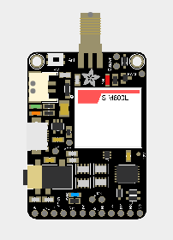



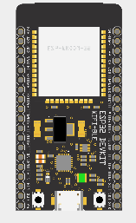

COMPONENTS USED
CONTROLLERS GAS SENSORS
GSM SIM800C MQ-135 MQ-2 MQ-7
(Nitrogen oxide sensor) (Hydrocarbon sensor) (Carbon monoxide sensor)
LCD Display
Node MCU ESP-32 WROOM
PROJECT-THIRD REVIEW ,
Department of CSE, KGiSL Institute of Technology, Coimbatore

Slide 13
FLOW CHART
START
Provide power to the system
Detect the CO,HC and NOx levels
NO
Exceed the gov standards
YES
Display the engine service indication and level of emission
Rectify the problem to reduce emission level
Yes
Emission level is Maitained
NO
Notify the transport office
YES
STOP
PROJECT-THIRD REVIEW ,
Department of CSE, KGiSL Institute of Technology, Coimbatore

Slide 14
MODULE SPLIT UP
MODULE 1- Circuit Design
MODULE 2- Private channel creation for Vehicle Emission Detection using Thingspeak
MODULE 3- Display output
MODULE-4 graphical representation of data in thingspeak and emission level through SMS
PROJECT-THIRD REVIEW ,
Department of CSE, KGiSL Institute of Technology, Coimbatore

Slide 15
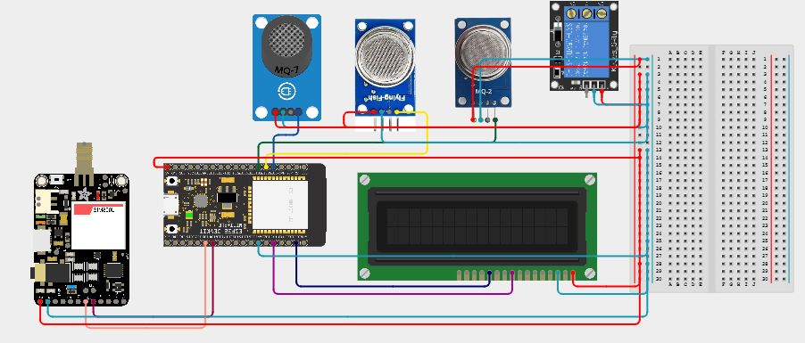
MODULE 1- Circuit Design
VEHICLE EMISSION DETECTOR
PROJECT-THIRD REVIEW ,
Department of CSE, KGiSL Institute of Technology, Coimbatore

Slide 16
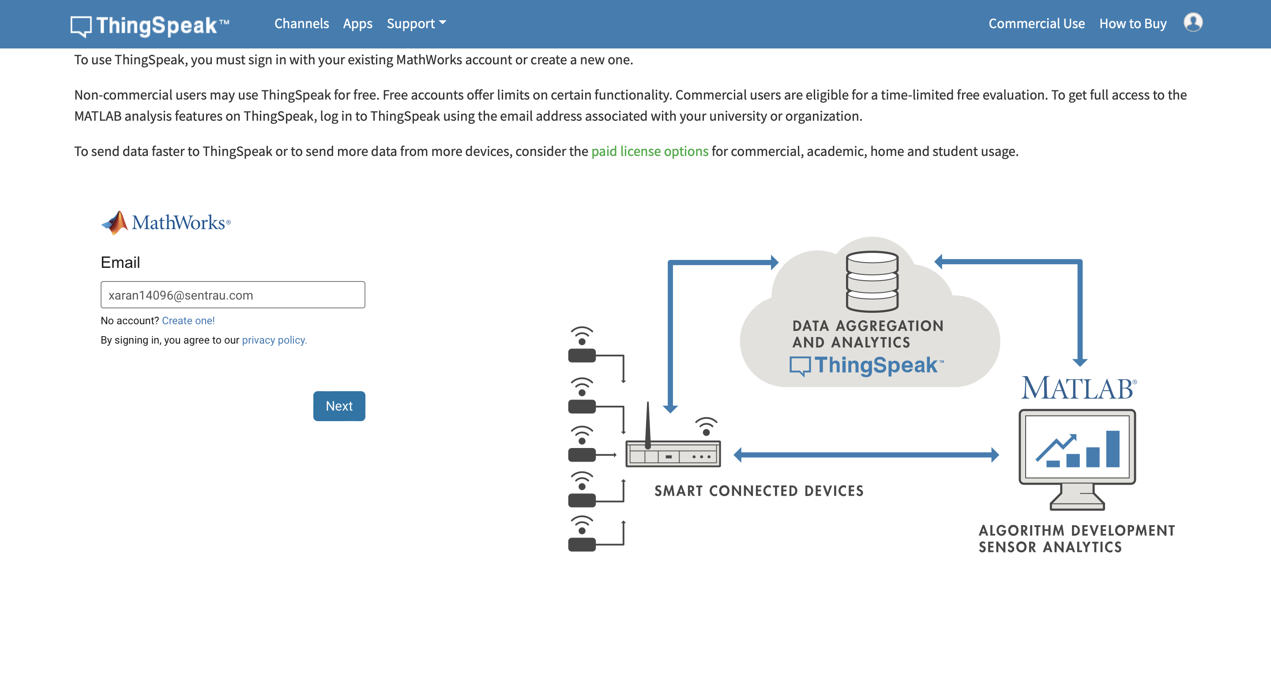
MODULE 2- Thingspeak
ThingSpeak allows you to aggregate, visualise and analyse live data streams in the cloud. With ThingSpeak, your data is stored in channels. Each channel stores up to 8 fields of data. You can create as many channels as you need for your application.
PROJECT-THIRD REVIEW ,
Department of CSE, KGiSL Institute of Technology, Coimbatore

Slide 17
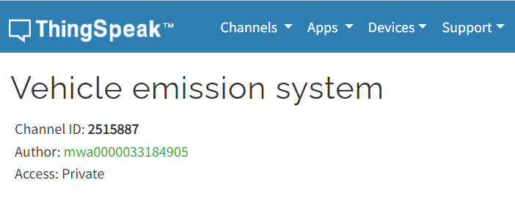
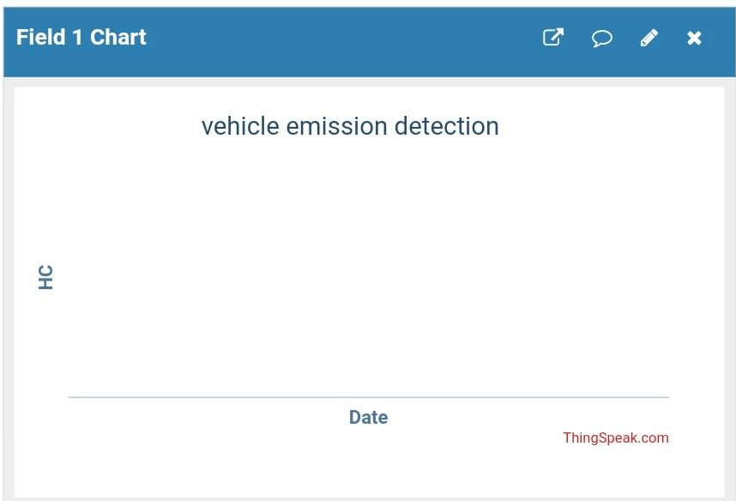
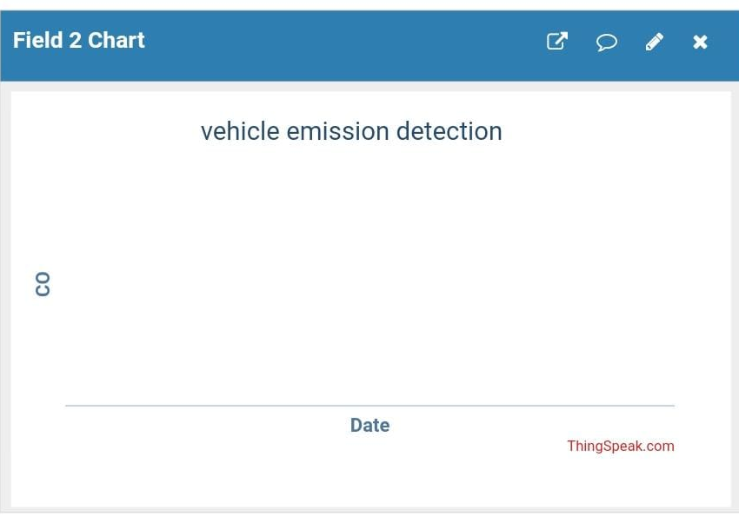

Private channel for Vehicle Emission Detection Thingspeak
Graphical representation of individual gases such as HC, NOx, CO.
PROJECT-THIRD REVIEW ,
Department of CSE, KGiSL Institute of Technology, Coimbatore

Slide 18
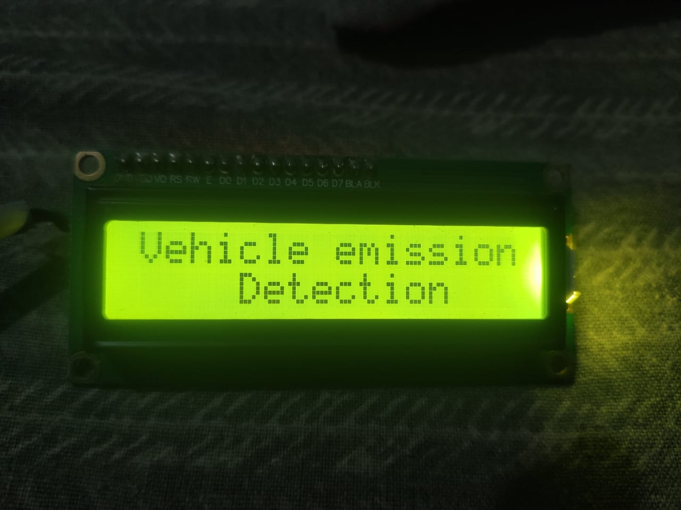
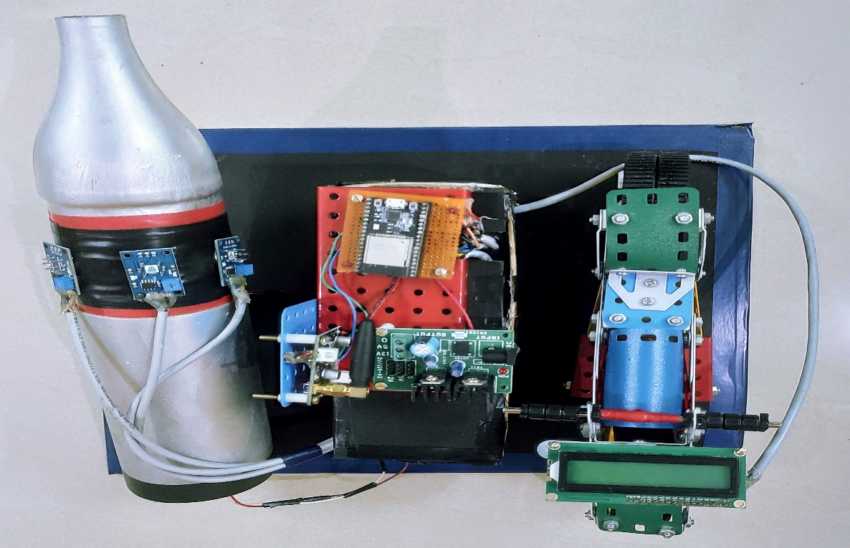
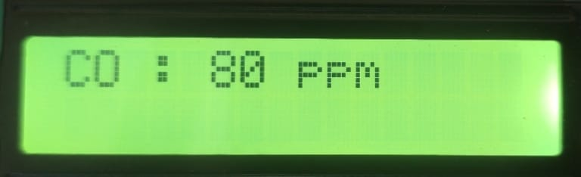
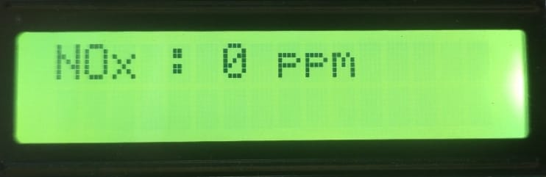
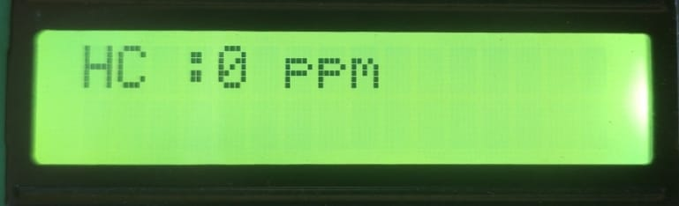
MODULE 3- Display output
The Display that shows the user real time emission level in the sequential order. It will be placed in the instrument cluster of the motorcycle which will help the user to view the real time emission of his motorcycle
PROJECT-THIRD REVIEW ,
Department of CSE, KGiSL Institute of Technology, Coimbatore

Slide 19
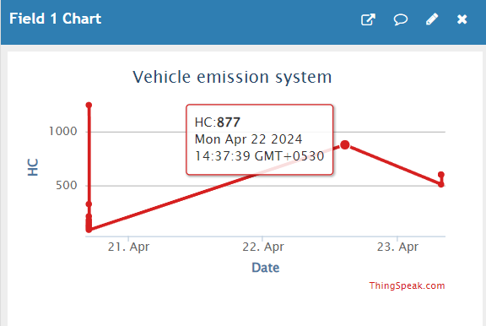
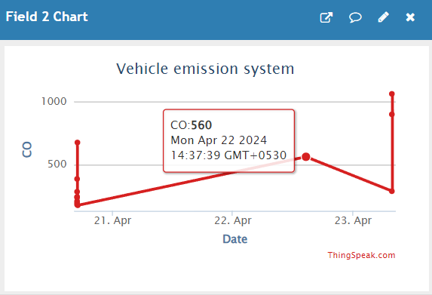
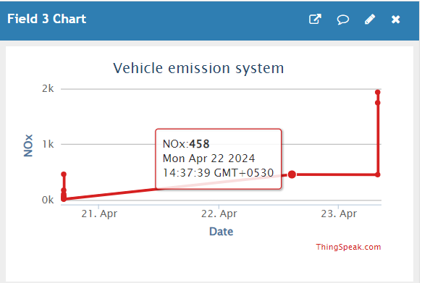
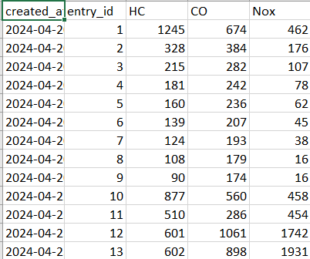
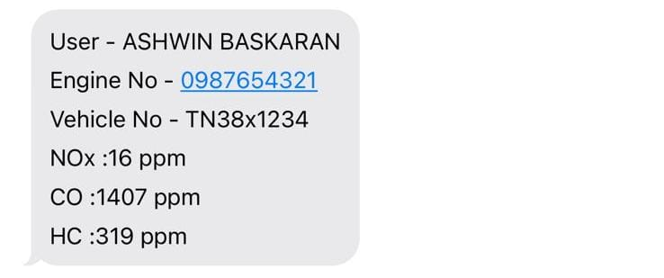
MODULE-4 graphical representation of data in thingspeak and emission level through SMS
PROJECT-THIRD REVIEW ,
Department of CSE, KGiSL Institute of Technology, Coimbatore

Slide 20
EXPECTED OUTCOME
The system we described utilises Mq2, Mq7, and Mq135 sensors to monitor emissions from vehicle exhaust, transmitting analog data to a controller with WiFi connectivity. The controller updates values to an LCD and cloud, triggering alerts when emissions surpass threshold limits. IoT integration facilitates cloud updates, with Node MCU enabling data transmission when WiFi is available. Alerts prompt vehicle owners to take action, with non-compliance leading to data sharing with transport authorities.
PROJECT-THIRD REVIEW ,
Department of CSE, KGiSL Institute of Technology, Coimbatore

Slide 21
REFERENCE
1.Goh Siew Yen1, Kohbalan Moorthy1*, Logenthiran Machap2, "IoT based Vehicle Carbon Monoxide Monitoring, Alerting and Controlling System", International Journal of Advanced Trends in Computer Science and Engineering ISSN: 2278-3091,Volume 9, No.1.5. 2020
2. Suvitha Vani P. Karthika S. Nabhanya K, Gowtham Ram S, Aishwarya Lakshmi N, "Vehicle Pollution Monitoring System using loT", International Journal of Recent Technology and Engineering (IJRTE) ISSN: 2277-3878, Volume-9 Issue-1, May 2020
3. Joseph Mathew Skaria Maliyekal, Shancy Elizabeth Shaji, Vandana H. Divya R S, "Vehicular Pollution Monitoring System Using IoT", Journal of Communication Engineering and Its Innovations DOI: 10.5281/zenodo.3570505, Volume 5 Issue 3. 2019
4. G.Arun Francis, M.Dhinesh, J.Arok Lijo, P.Hariprasad, K.Balasubramanian, "IoT Based Vehicle Emission Monitoring System", International Journal of Innovative Technology and Exploring Engineering (IJITEE) ISSN: 2278-3075, Volume-8 Issue-58 March, 2019
PROJECT-THIRD REVIEW ,
Department of CSE, KGiSL Institute of Technology, Coimbatore

Slide 22
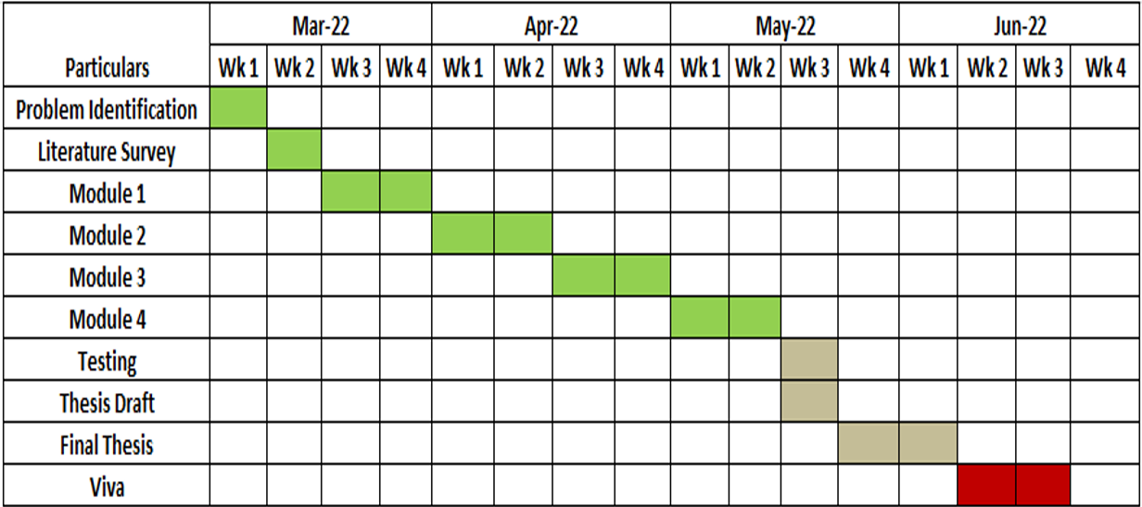
TIMELINE
PROJECT-THIRD REVIEW ,
Department of CSE, KGiSL Institute of Technology, Coimbatore

Slide 23
THANK YOU
PROJECT-THIRD REVIEW ,
Department of CSE, KGiSL Institute of Technology, Coimbatore

